Slide 1
Microwave Devices E511
Lecture 13
Amr Al.Awamry

Slide 2
Agenda
Filter Implementation

Slide 3
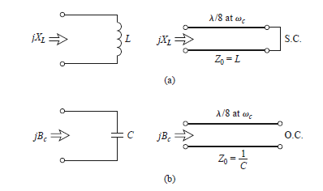
Filter Implementation
Richards’ Transformation
@ resonance frequency

Slide 4
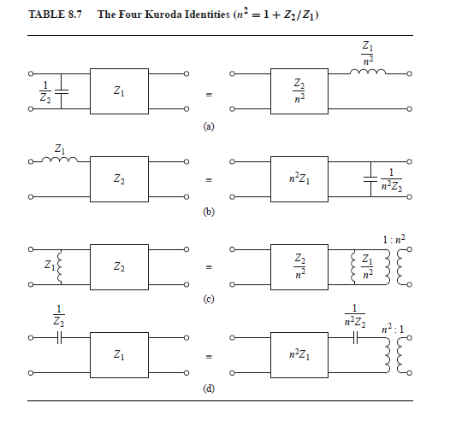
Kuroda’s Identities
* Physically separate transmission line stubs
* Transform series stubs into shunt stubs, or vice versa
*Change impractical characteristic impedances into more realizable values

Slide 5
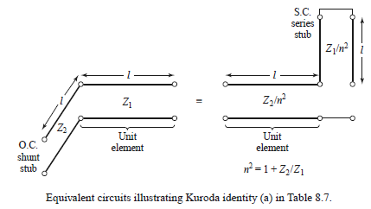
Kuroda identities , cont.

Slide 6
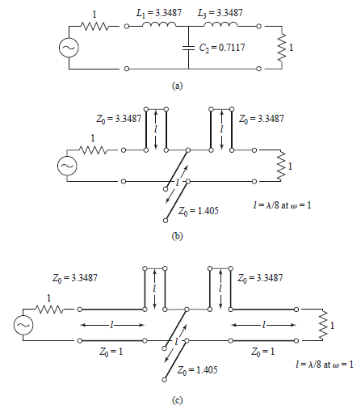
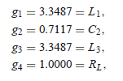
Example 8.5
Design a low-pass filter for fabrication using microstrip lines. The specifications include a cutoff frequency of 4 GHz, an impedance of 50 ohm , and a third-order 3 dB equal-ripple passband response

Slide 7
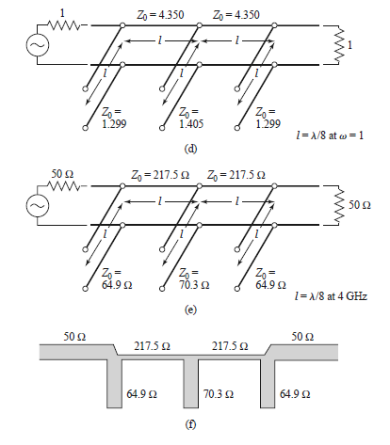
Example 8.5 cont.

Slide 8
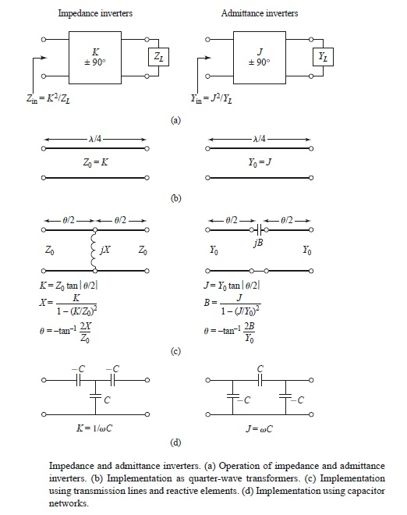
Impedance and Admittance Inverters

Slide 9
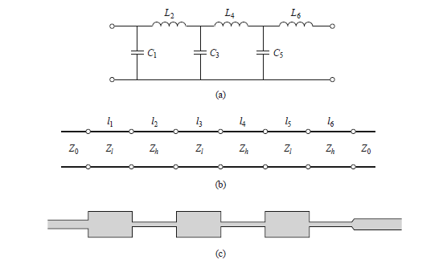
Stepped impedance design

Slide 10
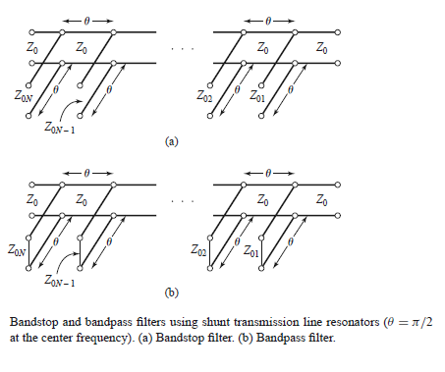
BandPass & BandStop filters
BandStop
BandPass

Slide 11
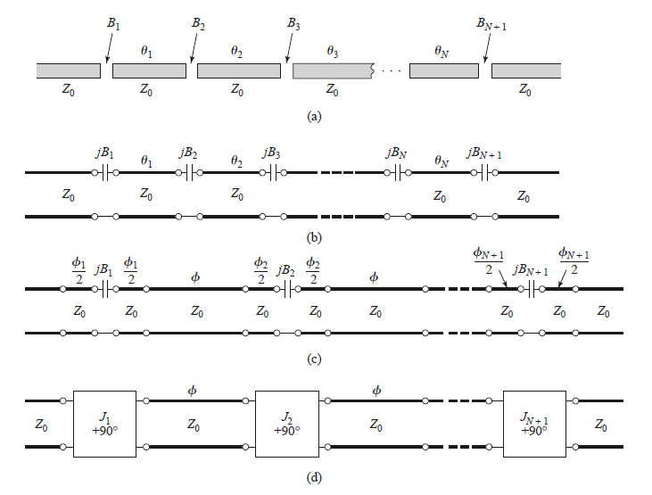
Bandpass Filters Using Capacitively Coupled Series Resonators

Slide 12
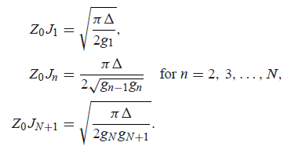
Bandpass Filters Using Capacitively Coupled Series Resonators II
Stub length equal λ/2

Slide 13
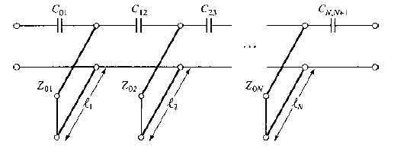
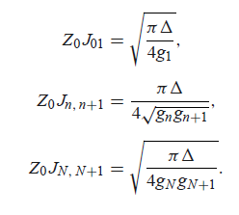
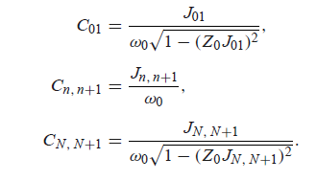
Bandpass Filters Using Capacitively Coupled Shunt Resonators
Stub length equal λ/4

